Slide 1

Amdocs Banking System
Guide :- Mr. Sandip

Slide 2



Agenda
Create a Bank project
Give the option to :
1.Deposit Money
2. Withdraw Money
3.Check Balance
4.Display Customer details

Slide 3

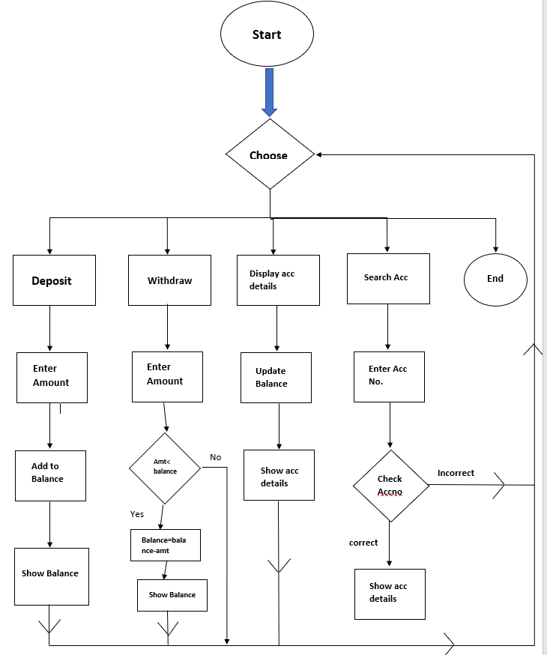
Flow chart

Slide 4
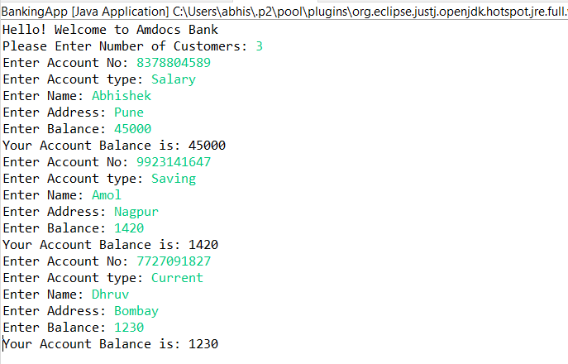
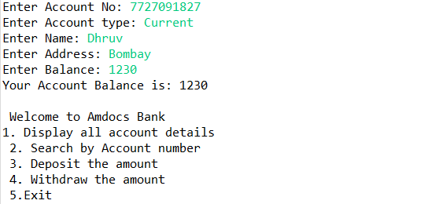
Output :
Enter customer details
Menu of functionalities

Slide 5
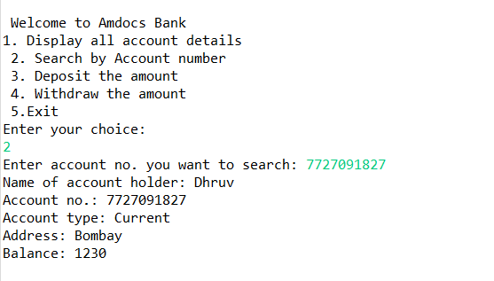
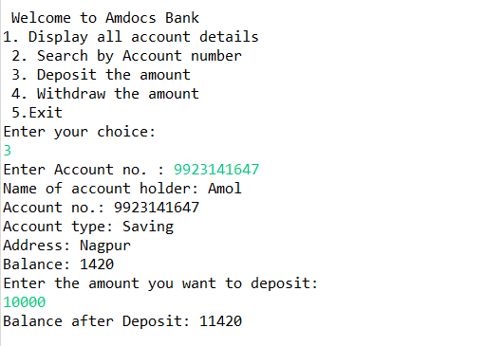
Output :
Search details by Acc no
Deposit

Slide 6
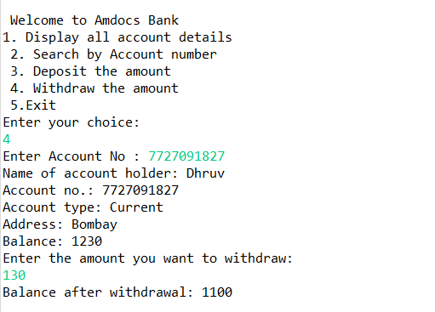
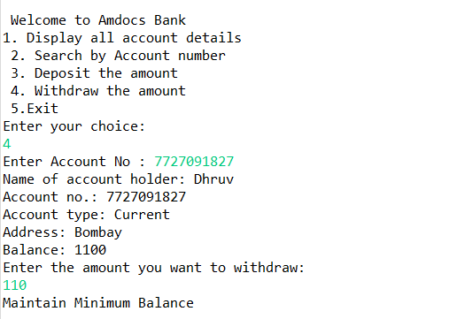
Output :
Withdraw from Account
Maintain Balance

Slide 7
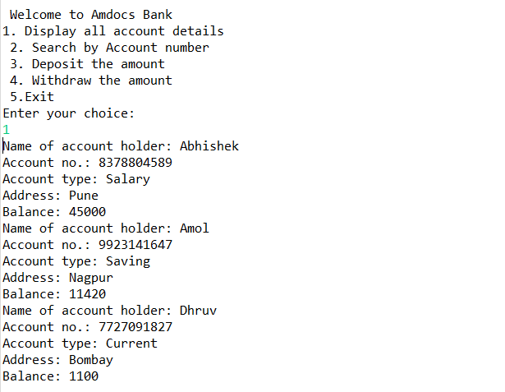
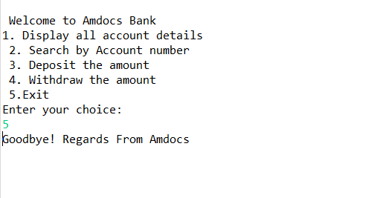
Output :
Customer details with final balance
Exit

Slide 8


Thank You
Abhishek Gadge
abhishek.gadge@amdocs.com

